Slide 1
[1]
flightPlanner: Flight Routing Engine
An optimal global flight path calculater using different path finding algorithms
Project Proposal by
Saeed Ahmed Mahin
BSSE 1703
Institute of Information Technology

Slide 2
[2]
Project Objectives
01. Large Scale Graph Construction
03. Concurrency & Optimization
Represent a massive flight network of 5,500+ airports and 130,000+ flights using an optimized adjacency list in standard C++. The data is collected from OpenFlights API.
Simulate and optimize for multiple concurrent users searching for flights simultaneously, ensuring thread-safe data access.
02. Advanced Algorithmic Routing
04. Algorithm Comparison
Implement and compare Dijkstra, Bi-directional Dijkstra, A*, and Bellman Ford Algorithm for multi-criteria pathfinding.
Finding the best Algorithm for flight mapping by showing the comparison of time required and airports discovered for each algorithm. Less is better!

Slide 3
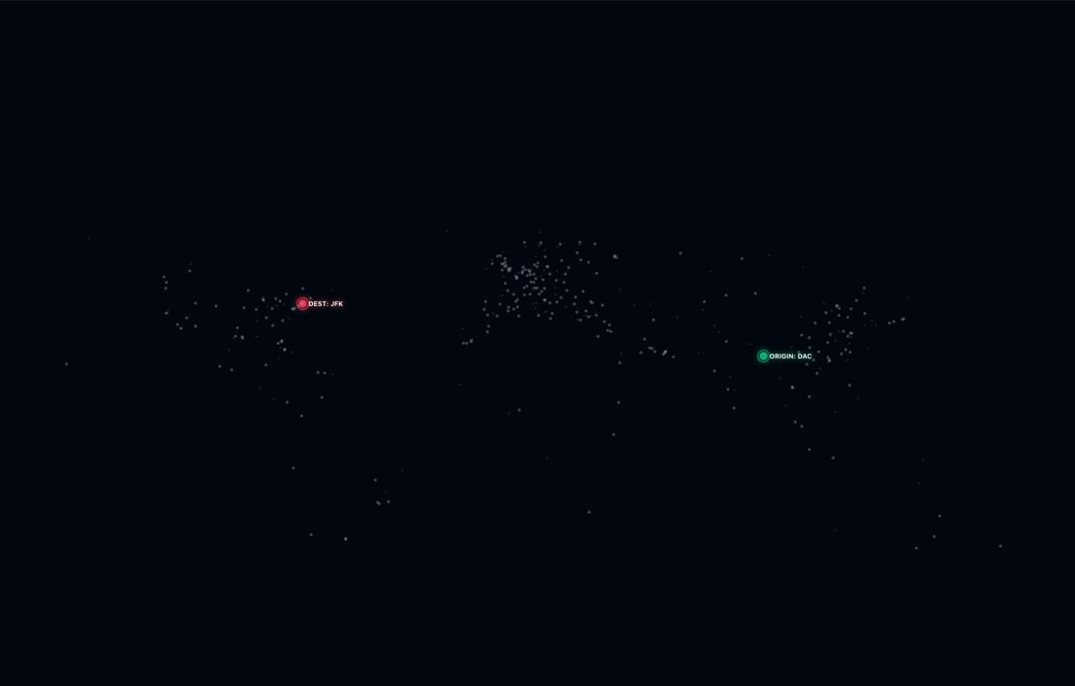


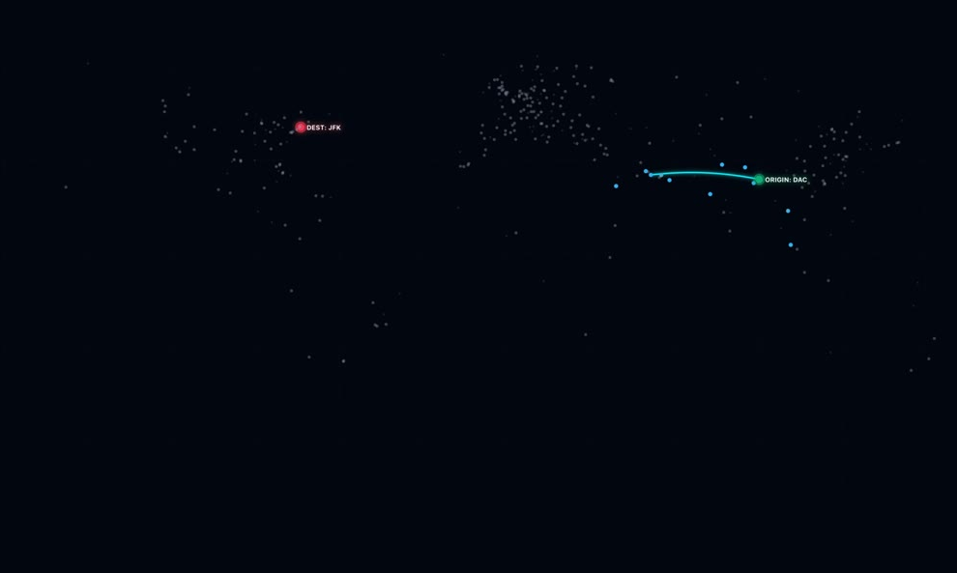
[3]
Bi-Dijkstra
Dijkstra
Bellman Ford
A*

Slide 4
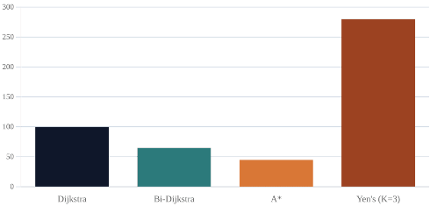
[4]
Expected Outcome
In Terminal:
Graphically:
$ flightPlanner --from DAC --to JFK --mode fastest
> Calculating optimal route...
> Found: DAC -> DXB -> JFK (18h 45m) (745 USD)
> Via Emirates EK-107 & EK-202
> Algorithm Rankings:
> 1. A*: 340 airports discovered in 28 ms.
> 2. Bi-Dijkstra: 1472 airports discovered in 82 ms.
> 3. Dijkstra: 3341 airports discovered in 192 ms.
> 4. Bellman Ford: 5465 airports discovered in 411 ms.
Dijkstra
Bi-Dijkstra
A*
Bellman Ford
NB: These are just hypothetical values without any statistical weight.

Slide 5
[5]
flightPlanner
Project Timeline (Fortnights)
0
1
2-MID
3
Initializing the project & Gaining required Knowledge
Parsing Data and Graph creation
Creating Algorithms
Fastest/Cheapest Route optimization & Comparison
4
5
6-FINAL
GUI Development
Testing
Visualizing Findings

